Slide 1
Gender Recognition by Voice​
PU FANYI | U2220175K
JIANG JINYI | U2220259H
SHAN YI | U2222846C
Notes:
Hello, my name is Pu Fanyi. And my group mates are Jiang Jinyi and Shan Yi. Today, i will present our mini project on machine learning. Our chosen topic is Gender Recognition by Voice.

Slide 2
Gender Recognition by Voice​

Slide 3
Table of Content
Motivation & Problem Formulation
Data Preparation & Exploratory Analysis
Machine Learning
Outcome & Insights
Notes:
These are the content of our presentation.

Slide 4
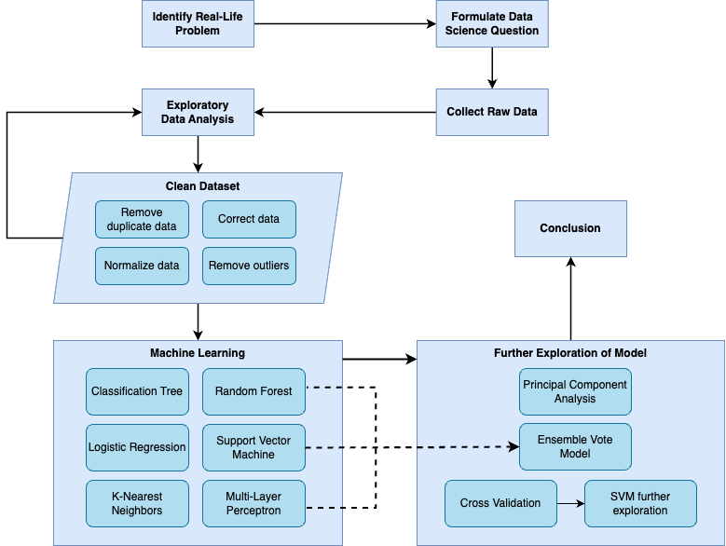
Notes:
And here is our planning.

Slide 5
Motivation &
Problem Formulation
01
Notes:
The first part is motivation and problem formulation

Slide 6

Motivation
Gender is strongly associated with voice.
The relationship between gender and voice has potential implications for various fields.
By learning and comparing various models, we can identify their strengths and weaknesses and potentially develop more accurate and reliable algorithms.
Notes:
Gender is linked to voice due to pitch, resonance, and other characteristics. This has implications for fields such as speech pathology, forensics, and human-computer interaction. The project aims to identify voice features that differentiate gender and evaluate classification models, to improve accuracy and reliability of algorithms.

Slide 7
Problem Formulation
Classify the gender of a speaker based on their voice characteristics
Main
Problem
Notes:
In this project, our main problem is to classify the gender of a speaker based on their voice characteristics.

Slide 8
Sub-Problems
01
02
What are the key features to classify the gender of a speaker through their voice?
Which model can predict the gender of a speaker with higher accuracy?
Notes:
To achieve this, we need to solve two sub-problems.
The first sub-problem is to identify the key features that classify the gender of a speaker through their voice.
The second sub-problem is to evaluate which models can better predict the gender of a speaker.

Slide 9


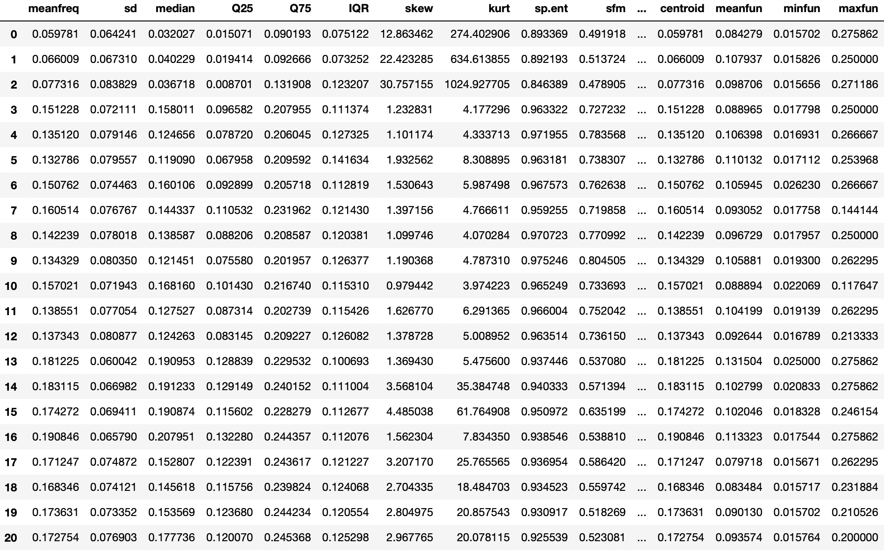
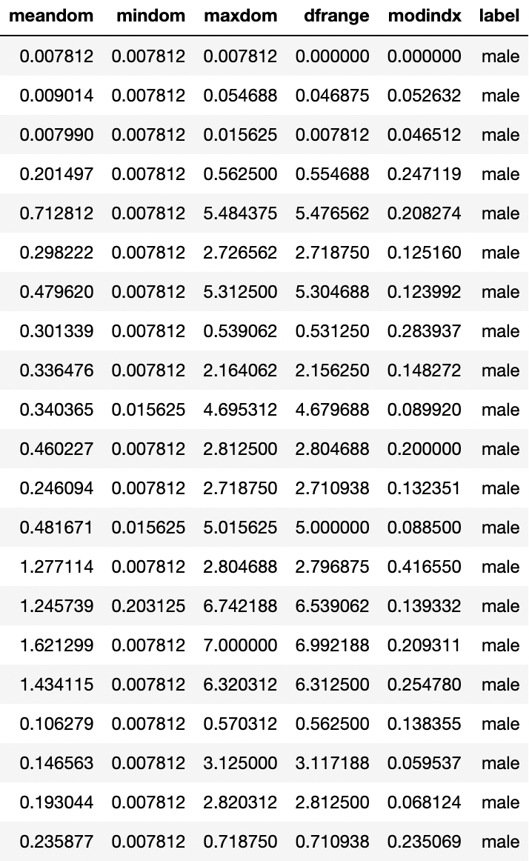
Sample Collection
https://www.kaggle.com/datasets/primaryobjects/voicegender
Notes:
We obtained the data from Kaggle, which consists of various recorded sounds that were analyzed using the warbleR package in R language. The package extracts different features of the sound signals and transforms them into a tabular format.

Slide 10
Data Preparation & Exploratory Analysis
02
Notes:
Lets move onto the next topic.

Slide 11
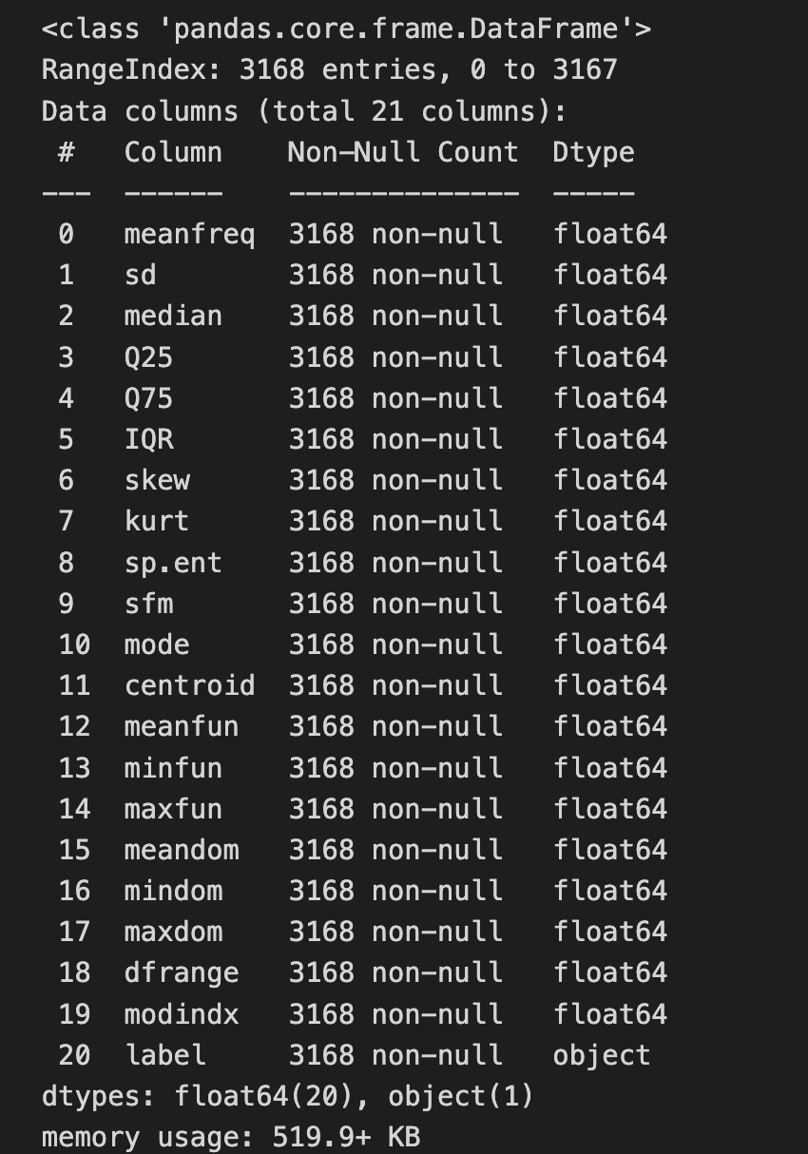
Dataset Information
3168 voice data
21 features
Half male
Half female
Notes:
Our project analyzes a dataset of 3168 voice data samples, which includes 21 features and is evenly split between male and female speakers.

Slide 12
Understanding Data
Central Tendency of Frequency
Fundamental Frequency Features
Dominant Frequency Features
Spread of Frequency
Spectral Features
meanfreq
median
Q25
Q75
centroid
IQR
sd
skew
kurt
sp.ent
sfm
mode
meanfun
minfun
maxfun
modindx
meandom
mindom
maxdom
dfrange
Notes:
We grouped the 20 predictors into five categories based on their respective characteristics. For each predictor, we conducted a thorough analysis to understand its contribution to the overall sound signal. By analyzing and understanding the features of sound signals, we were able to develop an effective approach to extract these features.

Slide 13

Remove Duplicate Data
meanfreq: mean frequency (in kHz)
centroid: frequency centroid
They have the same definition!
Notes:
To ensure the quality and accuracy of our data, we conducted several data preprocessing steps.
Firstly, we removed duplicate data predictors "meanfreq" and "centroid" since they provide the same information. This helps to eliminate redundancy and reduce computational burden.

Slide 14
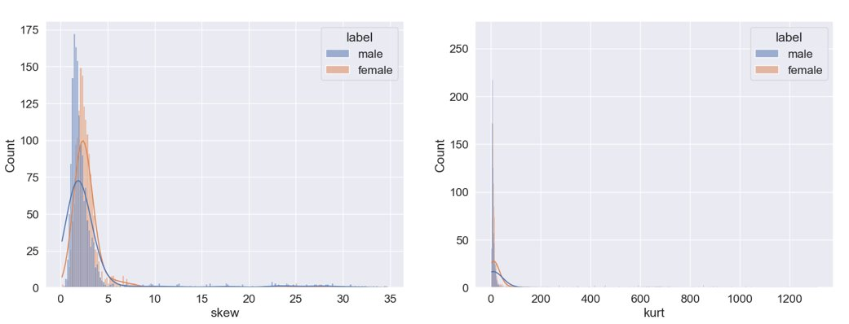
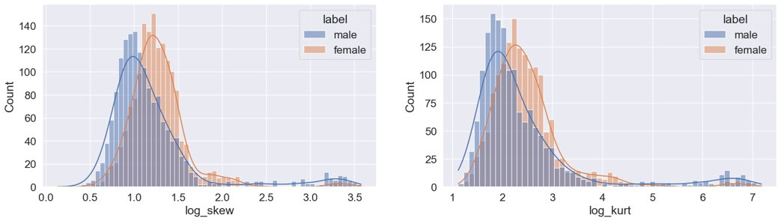

Data Correction
$$x′=ln\left(x+1\right)$$
Notes:
Secondly, we applied a log transformation. This helped to reduce the impact of extreme values and normalize the distribution of the data.
As a result, our model became more accurate by reducing the influence of outliers and skewness in the data.

Slide 15

Data Normalization
Many models are sensitive to the scale of input features.
Two points: $\left(0, 0\right), \left(1, 1000\right)$
The main contributor to the distance is $y$.
Ensure fair feature weighting.
$x^{′}=\frac{x−\overline{x}}{σ}$, where $σ$ is the distance deviation of $x$.
Notes:
Thirdly, we normalized the data to ensure that all features are treated equally in terms of their scale.
With normalization, the accuracy of our SVM model is greatly improved
This improvement is due to the fact that normalization allows the SVM to focus on the most informative predictors and reduces the noise caused by the less informative ones.

Slide 16
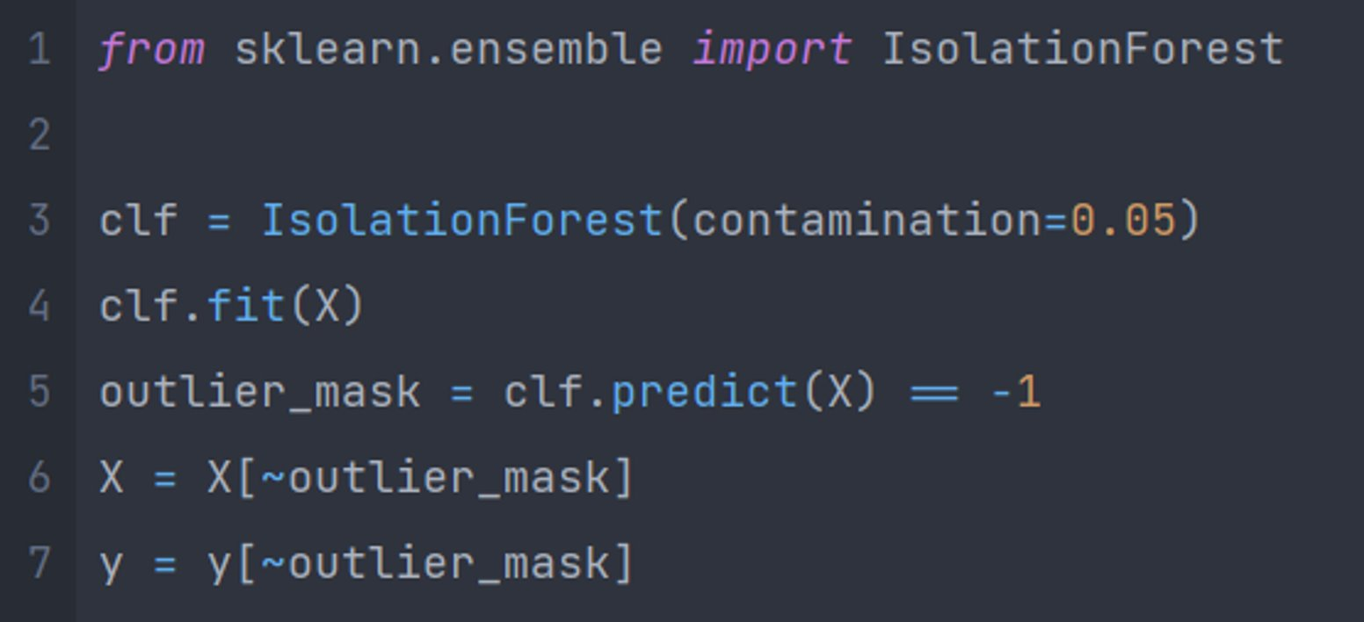
Outliers Removal
Notes:
Finally, we used the Isolation Forest algorithm to identify and remove outliers from the input data.
This algorithm can efficiently identify and remove outliers without relying on the assumptions of the data distribution.

Slide 17
Machine Learning
03
Notes:
The third part is about the machine learning of our data.

Slide 18
Machine Learning
Tree Based Algorithms
Classification Tree
Random Forest
Numerical Algorithms
Logistic Regression
K Nearest Neighbour
Support Vector Machines
Multi-Layer Perceptron
Further Exploration
Cross Validation
Support Vector Machines
Principal component analysis
Ensemble Vote model
Notes:
We divided our machine learning into 3 topics which are tree based algorithms, numerical algorithms and further exploration.

Slide 19
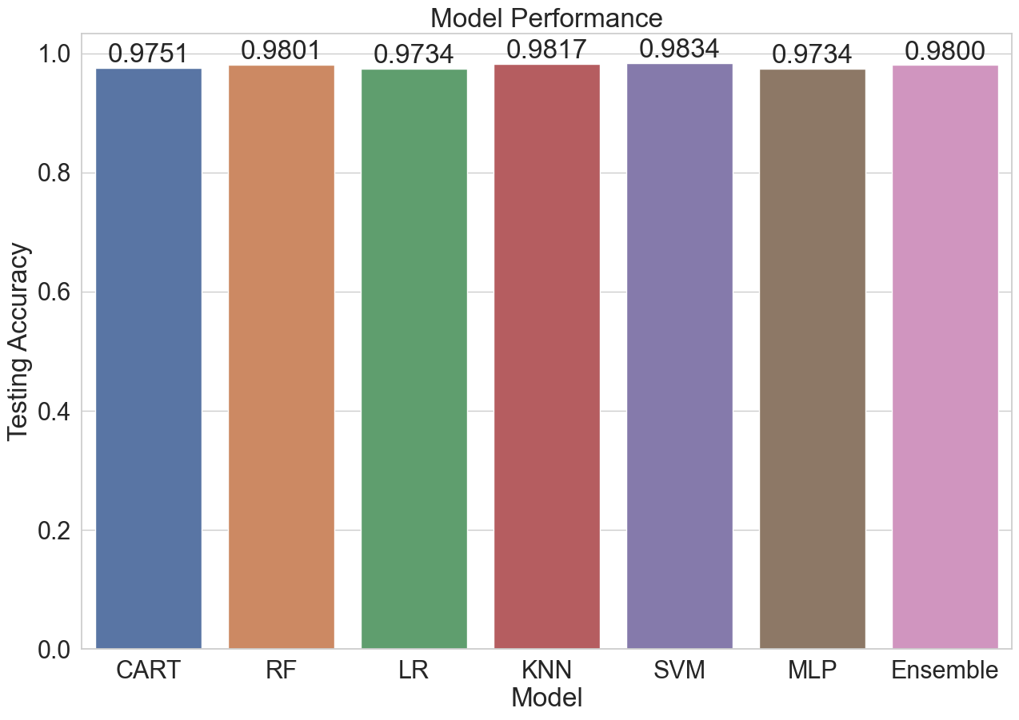
Machine Learning Overview
Model | Training | Testing
Classification Tree | 1.0000 | 0.9751
Random Forest | 1.0000 | 0.9801
Logistic Regression | 0.9763 | 0.9734
K-Nearest Neighbors | 1.0000 | 0.9817
Support Vector Machine | 0.9896 | 0.9834
Multi-Layer Perceptron | 1.0000 | 0.9734
Ensemble Vote | 1.0000 | 0.9800
Notes:
Here is our results. After performing data cleaning, we discovered that our models performed exceptionally well. This indicates that the extracted features of the sound signals are indeed highly correlated with gender. Then, we select some models for detailed learning and exploration.

Slide 20
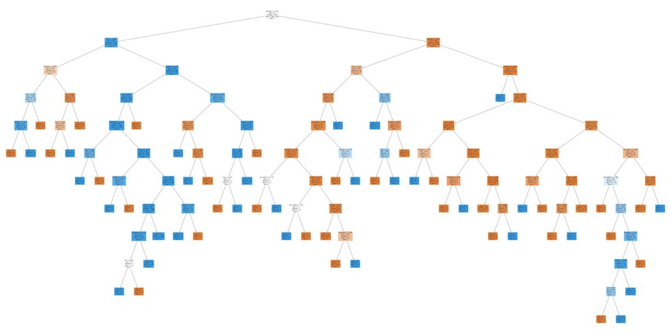
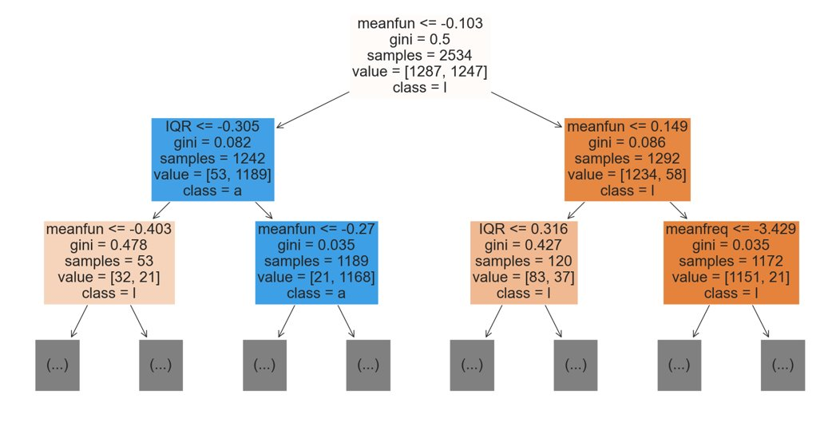
Classification Tree (CART)
The most important two variables:
IQR​ and meanfun
Notes:
Classification tree is the content we learnt from our class. By generating the binary tree, we noticed that the meanfun and IQR show up in the beginning of the tree which means these two features are the top two important factors.

Slide 21
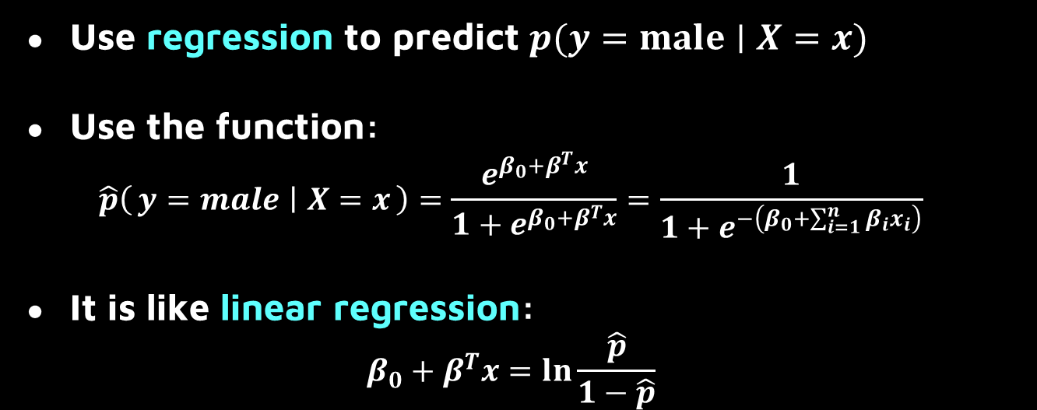
Logistic Regression
Use regression to predict $p(y=male∣X=x)$
Use the function:
$$\hat{p}\left(y=male ∣ X=x\right)=\frac{e^{β_{0}+β^{T}x}}{1+e^{β_{0}+β^{T}x}}=\frac{1}{1+e^{−\left(β_{0}+\sum_{i=1}^{n}{β_{i}x_{i}}\right)}}$$
It is like linear regression:
$$β_{0}+β^{T}x=\ln{\frac{\hat{p}}{1−\hat{p}}}$$
Notes:
Logistic Regression transforms a classification problem into predicting probabilities, and modifies the equation to convert the problem into a linear regression problem。

Slide 22
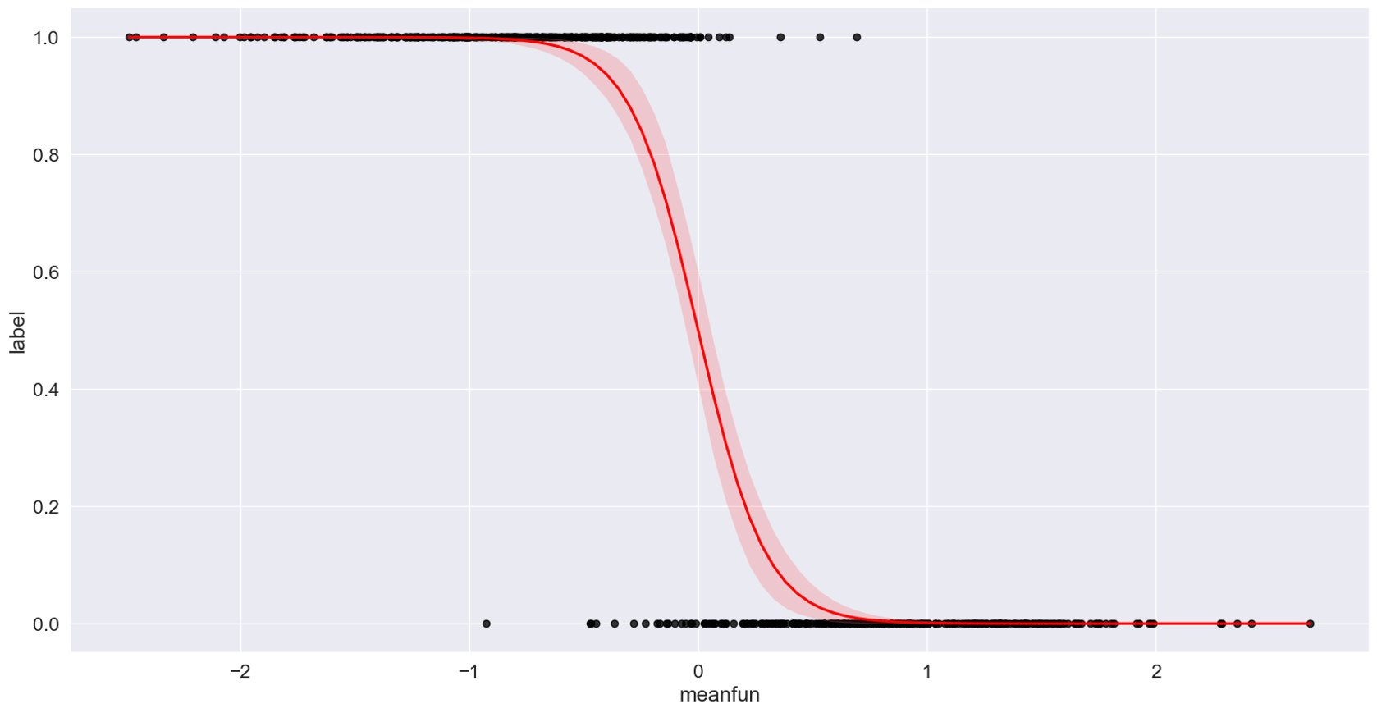
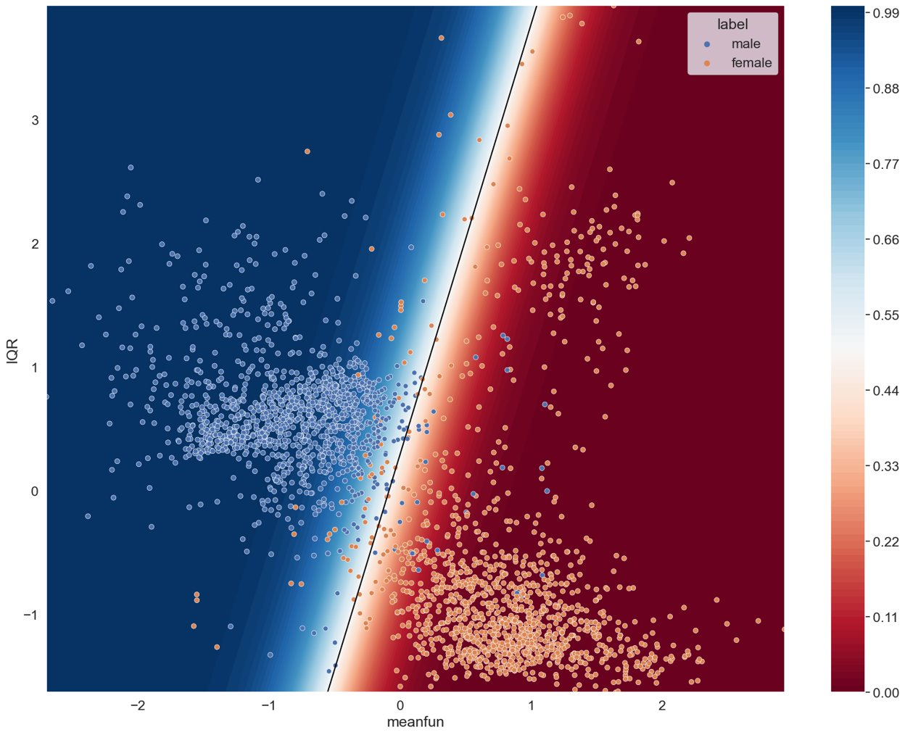
Logistic Regression Demonstration
Notes:
We have drawn the performance of logistic regression in one-dimensional and two-dimensional scenarios, allowing us to gain a deeper understanding of the process.

Slide 23
Cross Validation (CV)
Evaluate, select models
Splits data into folds
Reliable performance assessment
Notes:
To further analysis the accuracy and efficiency of our algorithm, we utilized cross-validation to evaluate the model's generalization performance and reduce overfitting.

Slide 24
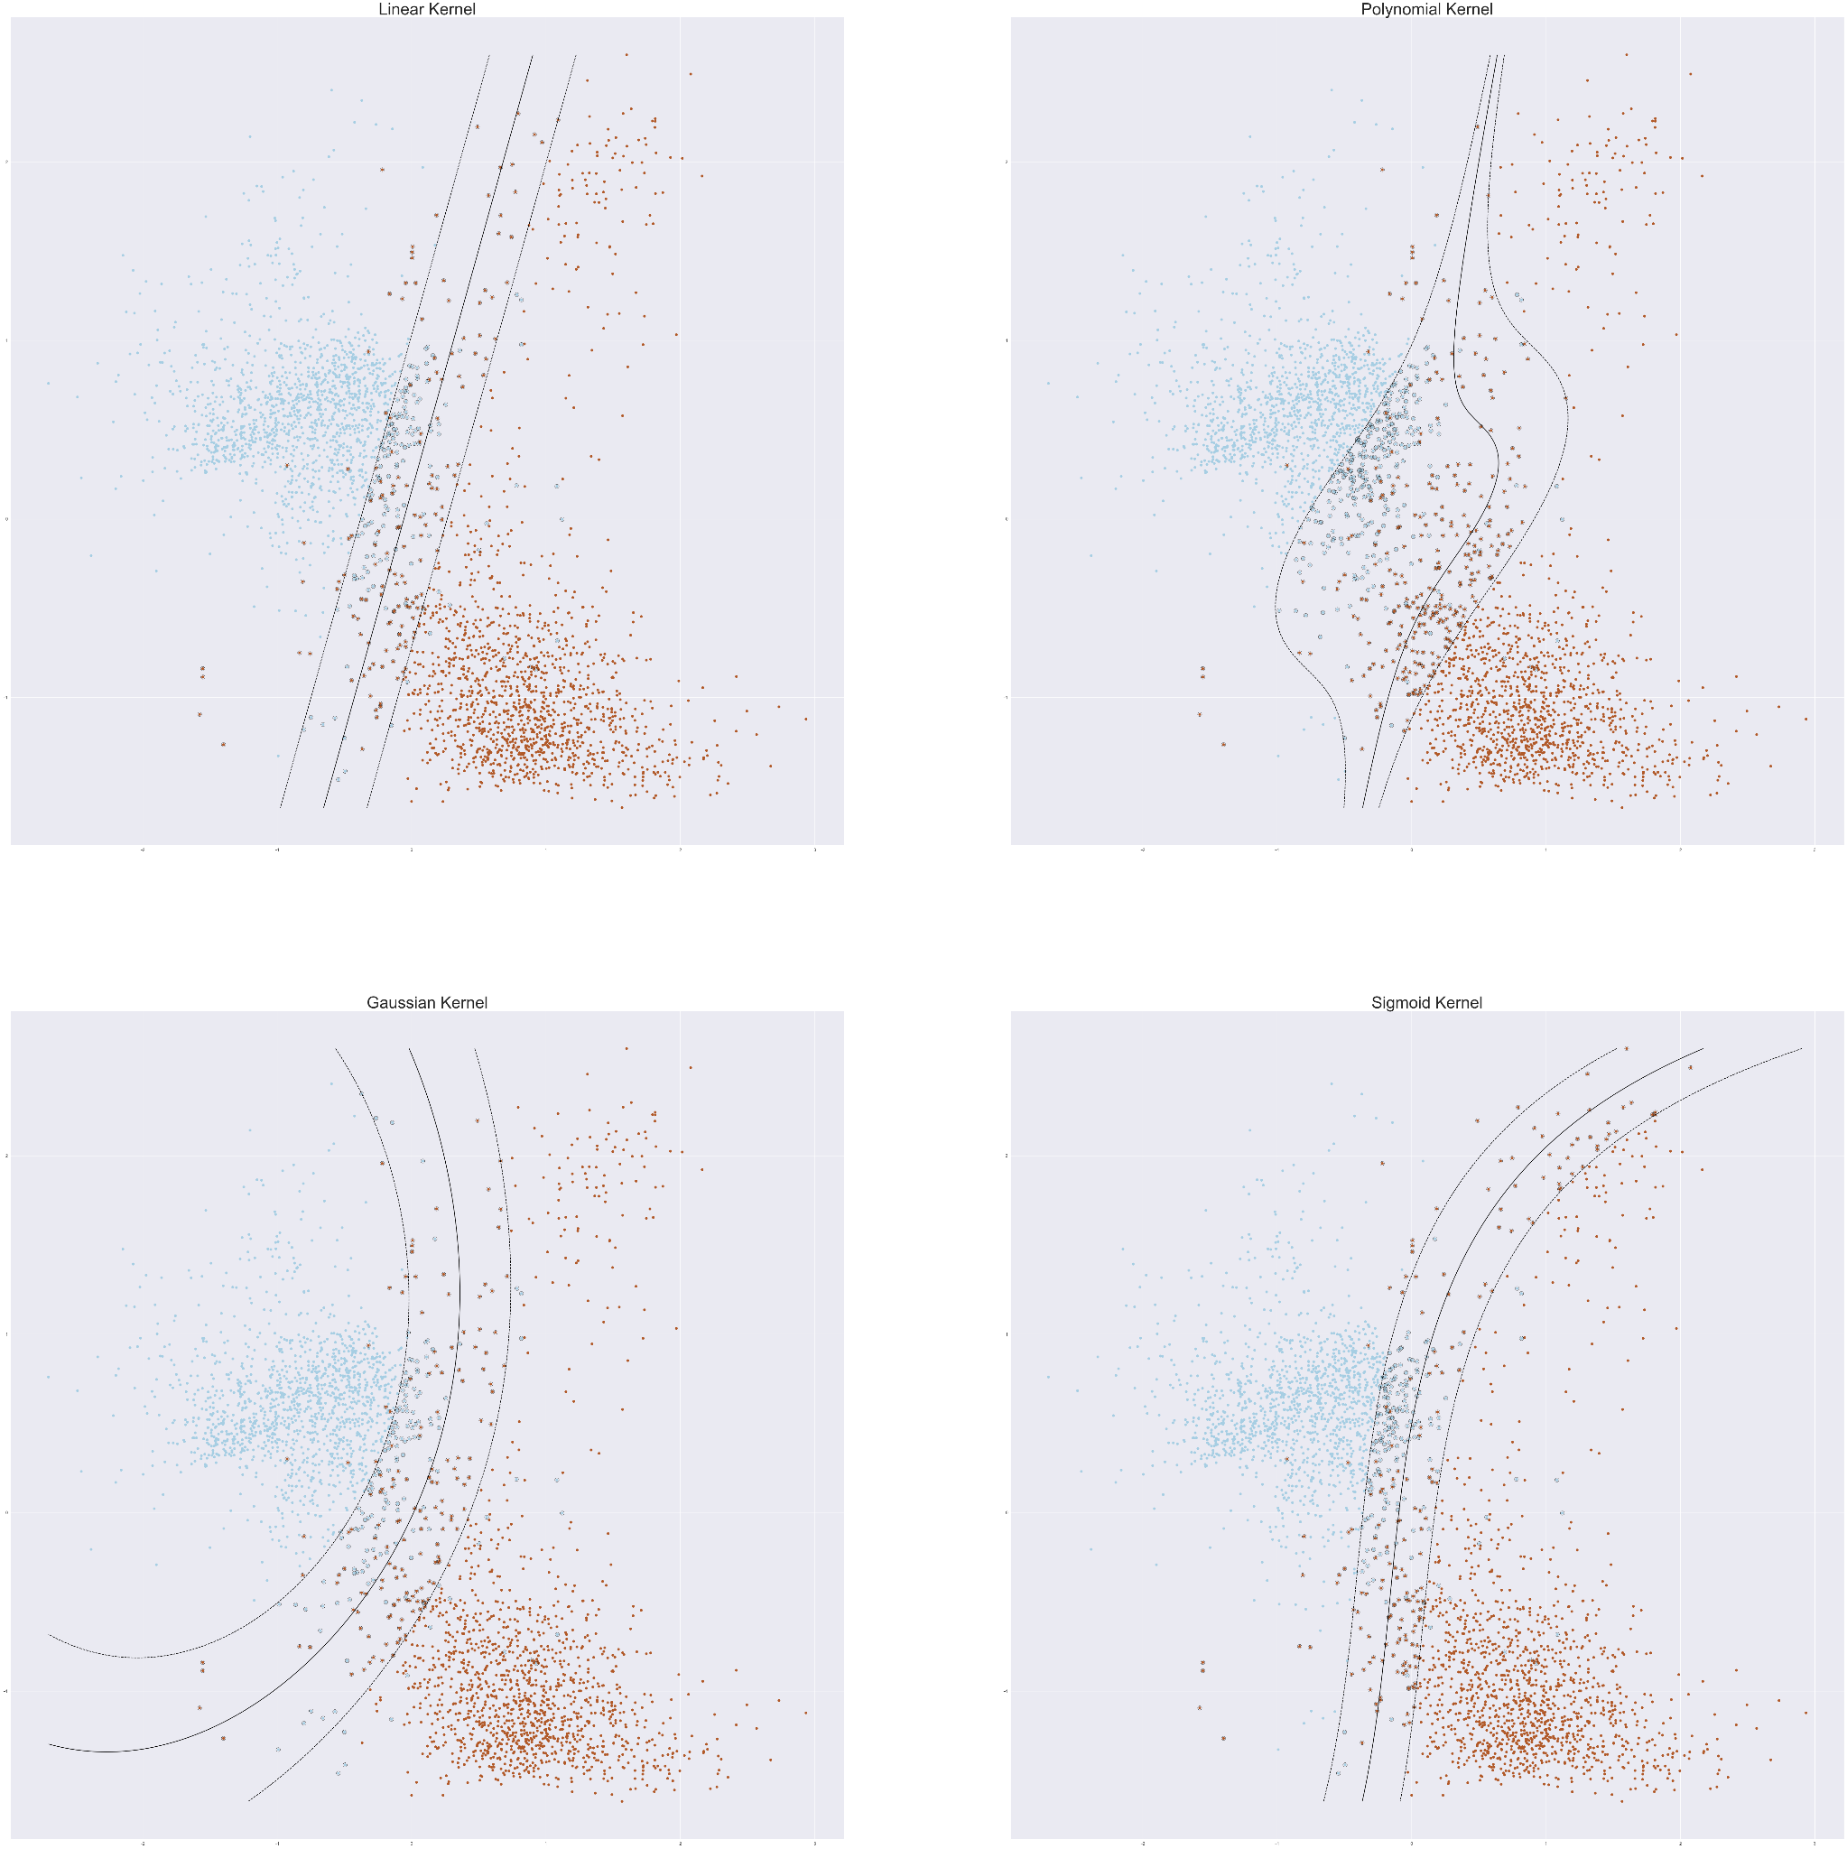

Support Vector Machines (SVM)
Main idea: hyperplane
4 types of Kernel
Linear: $x^{T}x′$
Polynomial: ${\left(x^{T}x^{′}+1\right)}^{d}$
Gaussian: $exp\left(−γ{\left|x−x^{′}\right|}^{2}\right)$
Sigmoid: $tanh\left(γx^{T}x^{′}+r\right)$
Notes:
Then, we delved deeper into SVM and began by selecting an appropriate kernel. We tried four types of kernels and plotted them on a two-dimensional plane. After comparing them thoroughly, we agreed that the Gaussian kernel performed the best on our dataset.

Slide 25
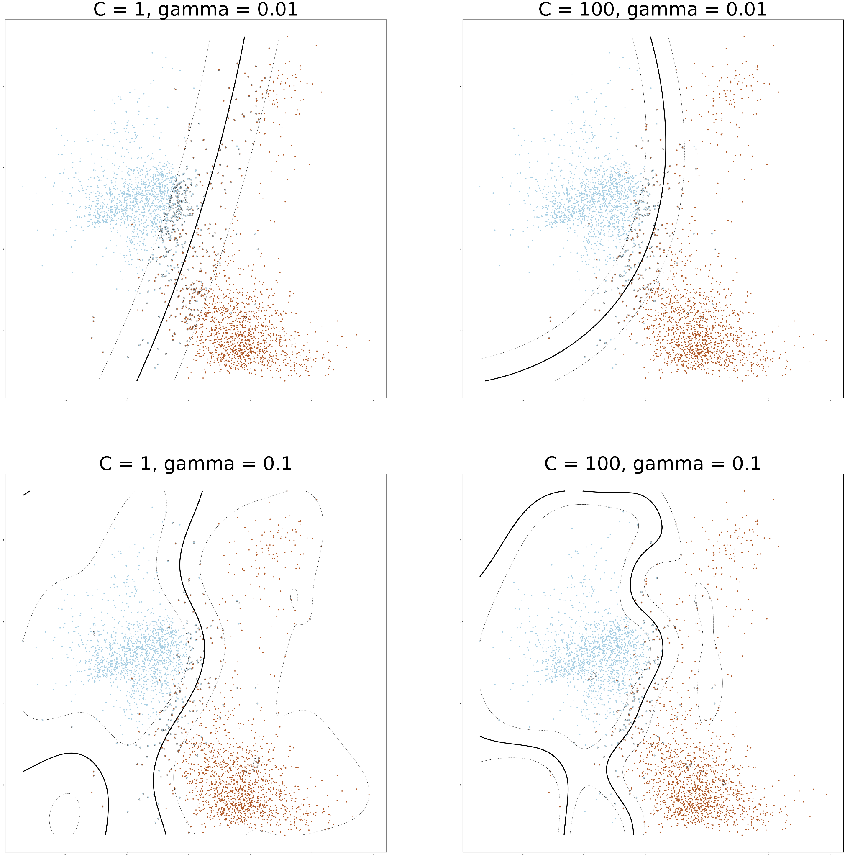

Support Vector Machines (SVM)
$γ$: determines smoothness
$C$: determines margin, misclassifications
Hill Climbing
$γ=0.0026, C=23.88$
Notes:
Then, we tried adjusting the size of gamma and C in SVM. Gamma controls the shape of the boundary, and C determines the trade-off between margin size and misclassifications. We plotted the hyperplane on a two-dimensional plane and tried various parameter values, as shown in four examples on the right. We then fine-tuned these parameters using the hill climbing algorithm and arrived at the final values.

Slide 26
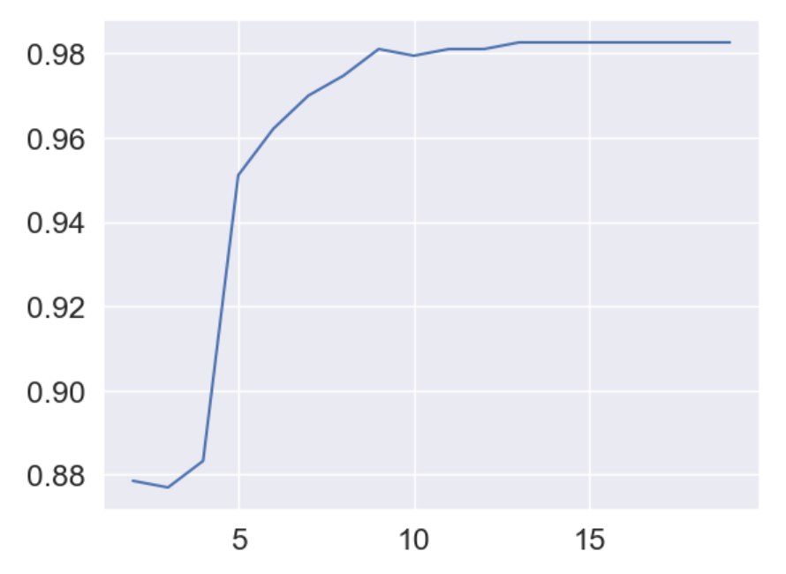
Principal Component Analysis (PCA)
Feature Compression
Improve Efficiency
Balance Between Accuracy and Efficiency
Notes:
We aimed to improve efficiency by compressing the predictor data using PCA. We found that when compressing the dimensions to 9 or higher, the accuracy hardly changed. Our findings demonstrate that by compressing the data to a certain degree, we can achieve a good balance between accuracy and efficiency, leading to better performance in our predictive modeling.

Slide 27
Ensemble Vote Model
Something we developed
Integrate the outputs of high-performing models
and select the majority vote
Not as ideal as we hoped
Notes:
During our project, we also developed an Ensemble Vote model which ask models to “vote” the answer to improve our prediction results. In our case, the accuracy of the Ensemble Vote model was not as ideal as we had hoped. This experience taught us the importance of carefully selecting and combining models based on their individual strengths and weaknesses, and considering the underlying assumptions and limitations of each model.

Slide 28
Outcome &
Insights
04
Notes:
Finally is the outcome and insights of our project.

Slide 29
Outcome and Data-Driven Insight
What are the key features to differentiate the gender?
Which models can better predict the gender of a speaker?
According to classification tree analysis, IQR and meanfun have been identified as the two main predictors for classifying male and female voices. A higher IQR and lower meanfun are more indicative of a male speaker.
Among the various models, we found that the SVM model with an RBF kernel achieved the highest accuracy, with a score of 0.9834.
Notes:
Through our classification tree analysis, we identified IQR and mean fundamental frequency as the key features that differentiate male and female voices. A higher IQR and lower meanfun are more indicative of a male speaker.
Among the various models we evaluated, the SVM model with an Gaussian kernel achieved the highest accuracy.

Slide 30
Recommendation
Application
Speech recognition
Security systems
Limitation
Non-acoustic factors
Practicality
Notes:
Application:
Our findings have practical applications in fields such as speech recognition. It is used in speech recognition software to identify the gender of the speaker and adjust the software's response accordingly. For example, a virtual assistant may use gender recognition to respond more naturally and personally.
As for the security systems, the voice can be used for authentication and access control.
Limitations:
Despite our promising results, there are limitations to our study.
The language of our dataset is English, and non-acoustic factors such as noise, accent, language, culture, and region can also affect how we perceive gender through voice in real-life situations.
Additionally, implementing these models in real-life scenarios may be limited due to the time, resources, and background situation required for data collection and model training.

Slide 31
What we learned
Importance of Data Preparation
Data normalization → significant improvement in accuracy
Exploring Various Machine Learning Models for Accurate Predictions
Supervised learning: CART, RF, LR, KNN, SVM
Unsupervised learning: PCA
Using CV to get the accuracy
Ensemble Vote Model
Carefully select models based on their individual strengths and weaknesses
Consider the underlying assumptions and limitations of each model
Notes:
Throughout our project, we learned about the importance of data preparation and how it can affect the performance of our models.
In particular, we saw how normalization greatly improved the accuracy of our model, which previously showed poor performance despite adjusting the parameters extensively.
We also gained a deeper understanding of various machine learning models, both supervised and unsupervised.
And developing the ensemble vote model was a valuable learning experience for us.

Slide 32
Thank you
Notes:
That's all for our presentation, thank you for your listening

